Slide 1
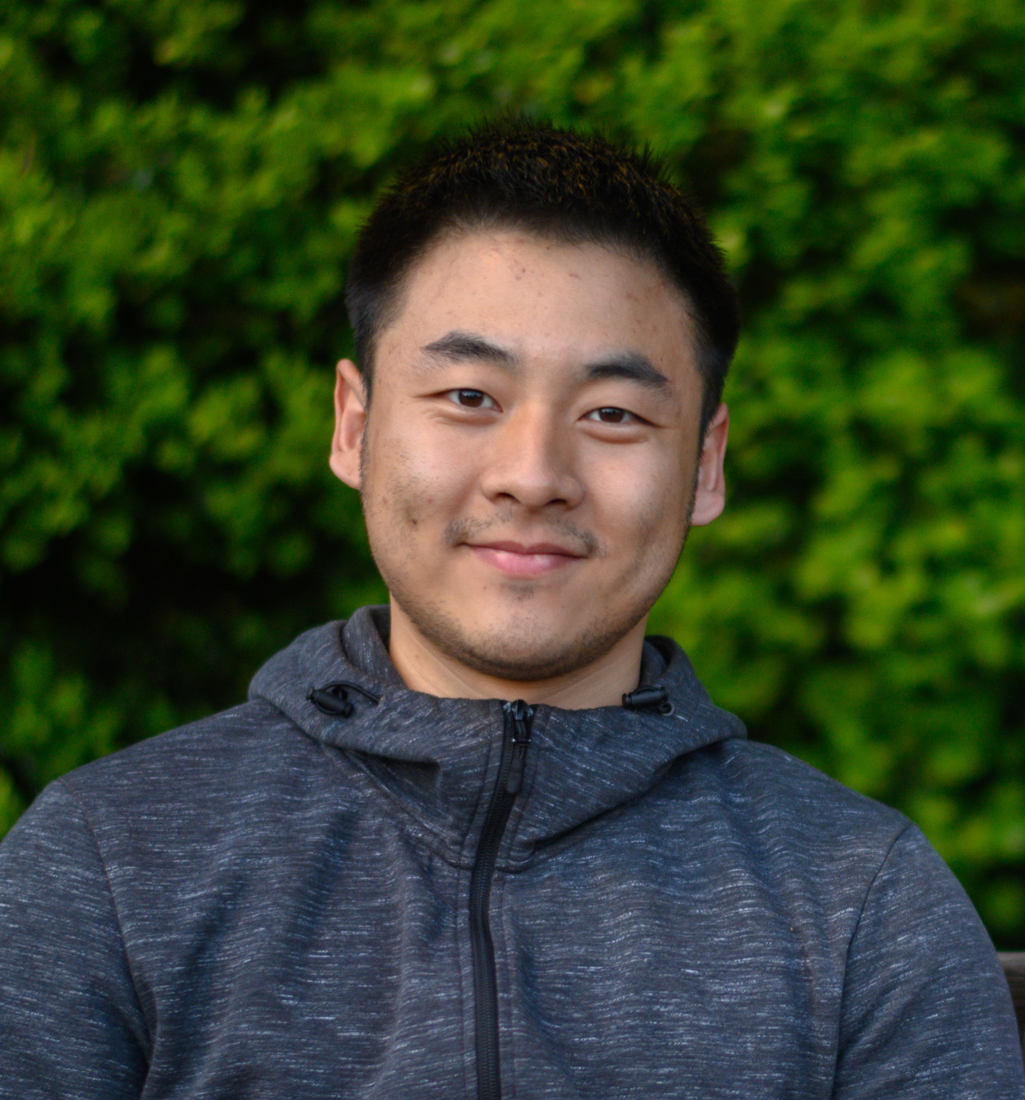
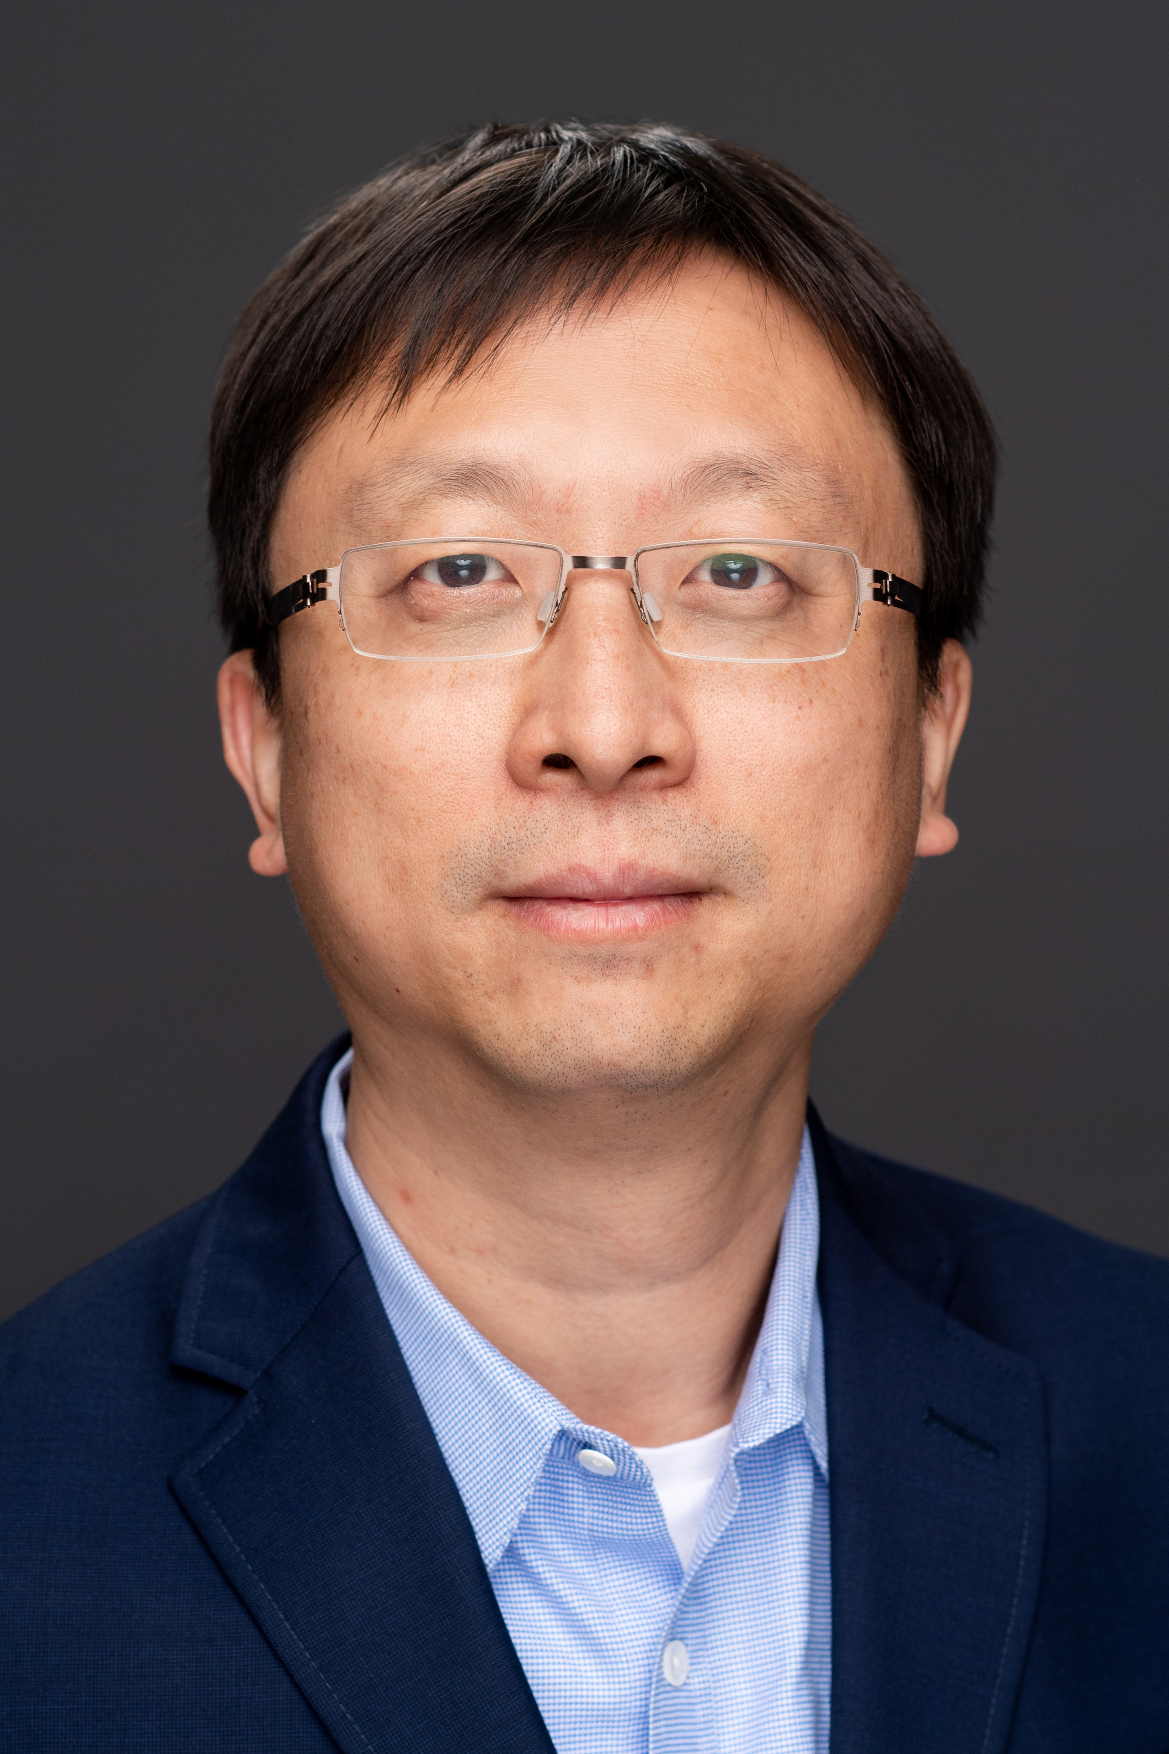
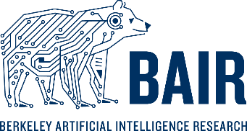
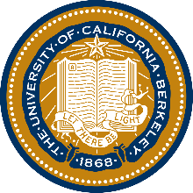
Neural Network Linearization for Out-of-Distribution Robustness
James Campbell¹, Yaodong Yu², Yi Ma²
1 Cornell University; 2 University of California, Berkeley

Slide 2
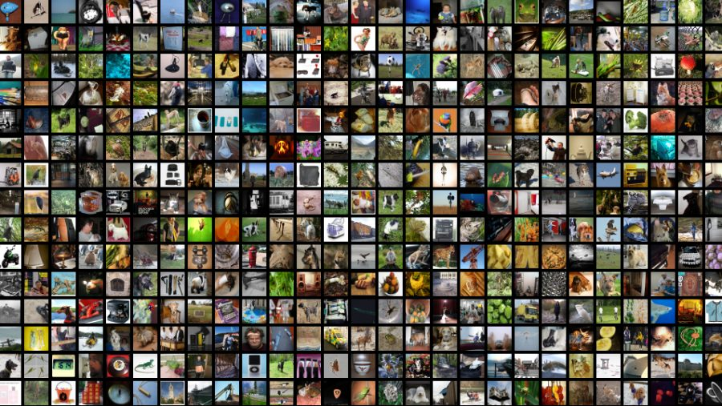
Deep Learning in 2022: Foundation Models
Practitioners download models that have been pretrained on massive, wide-ranging datasets, which are then “fine-tuned” for specific use-case

Slide 3
Deep Learning in 2022: Foundation Models
Given a pretrained model, what’s the best way to use it?

Slide 4
Deep Learning in 2022: Foundation Models
“Fine-tuning”

Slide 5
Deep Learning in 2022: Foundation Models

Slide 6
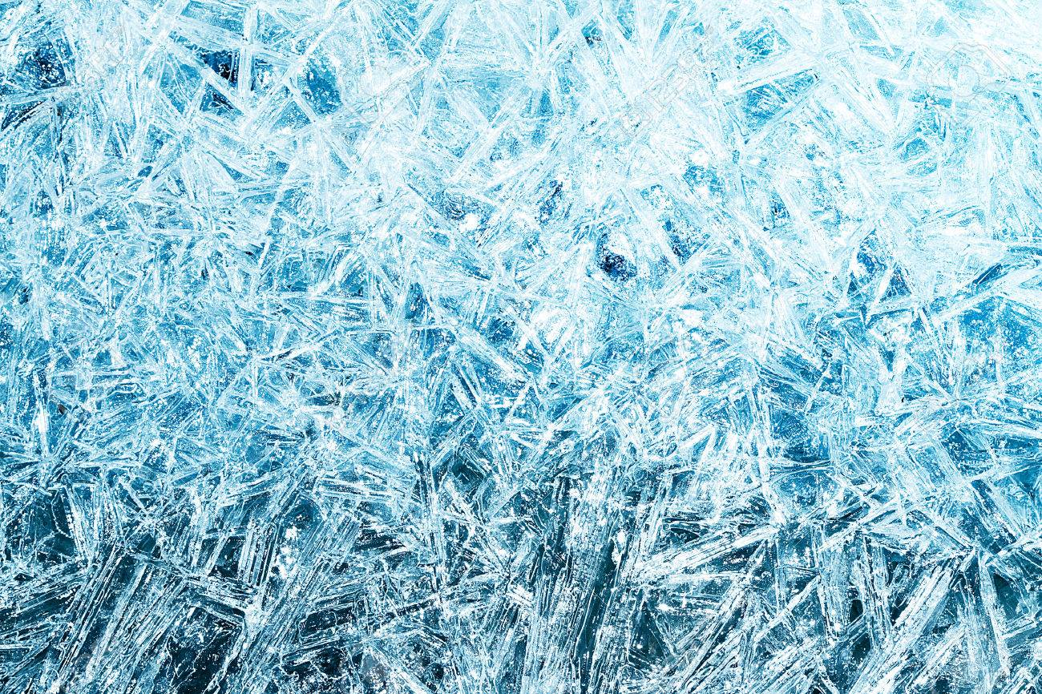
Deep Learning in 2022: Foundation Models
“Linear Probing”
“Freeze”

Slide 7
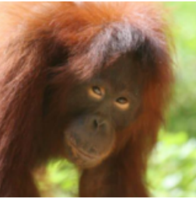
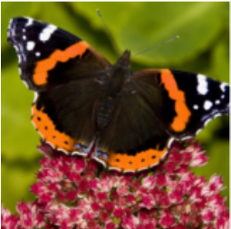
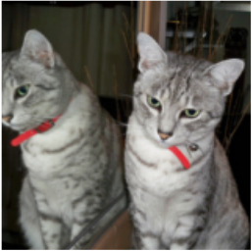
The Real World: Distribution Shifts
Bear
Ape
Butterfly
Cat

Slide 8
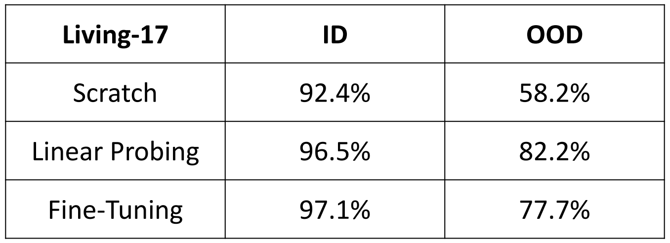
The Real World: Distribution Shifts
In-distribution
Out-of-distribution

Slide 9
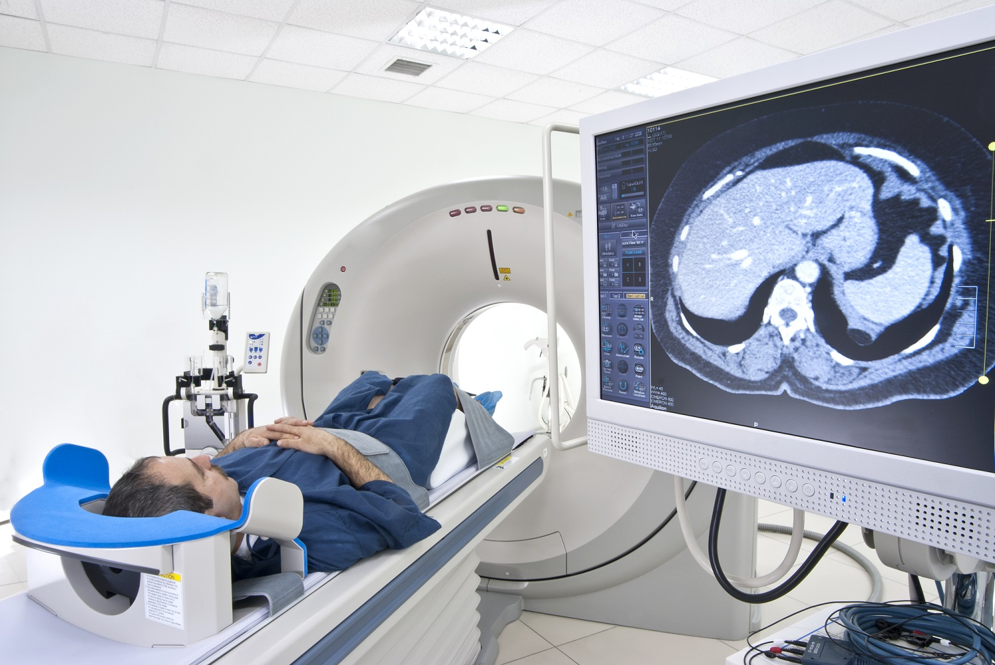
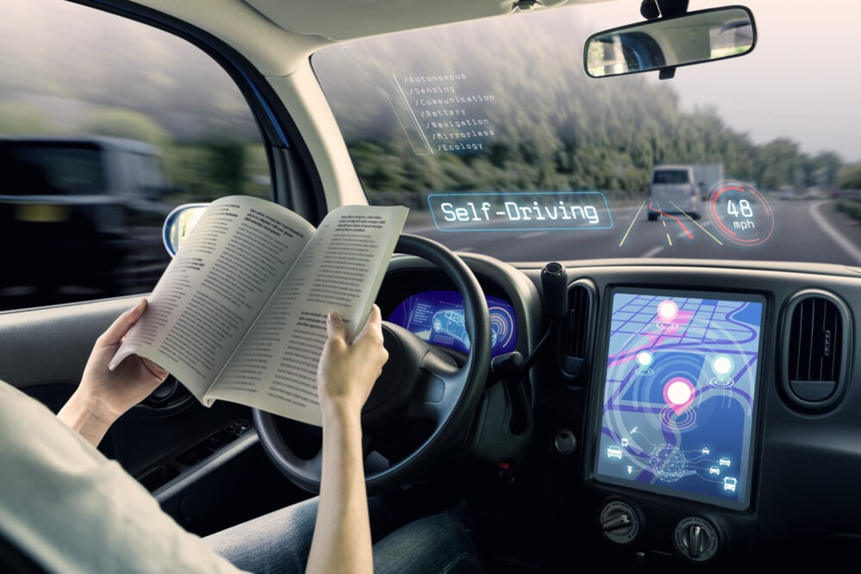
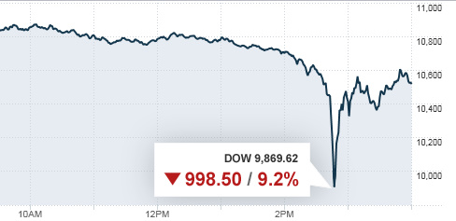
The Real World: Distribution Shifts
Unavoidable, ubiquitous, subtle, dangerous
“Things that have never happened before happen all the time.” Scott D. Sagan

Slide 10
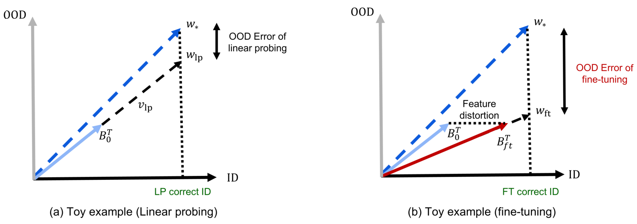
Kumar et al.: Feature Distortion Theory

Slide 11
My approach: Linearize the network (aka the eNTK)

Slide 12
My approach: Linearize the network (aka the eNTK)
“Just Taylor expand it!” –every physicist ever

Slide 13
My approach: Linearize the network (aka the eNTK)

Slide 14
Neural Network Linearization: the eNTK

Slide 15
Neural Network Linearization: the eNTK

Slide 16
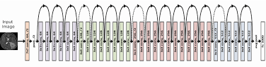
Neural Network Linearization: the eNTK
500,000

Slide 17
Method: Kernel Regression on eNTK features
eNTK(x)

Slide 18
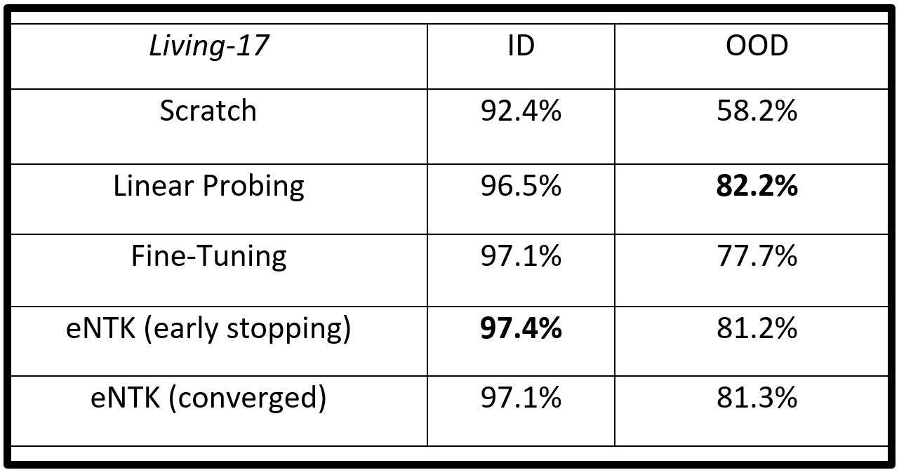
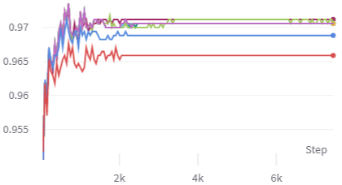
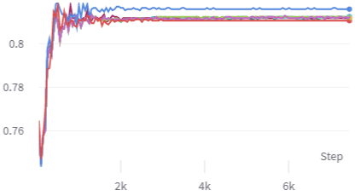
Results on Living-17
eNTK better than standard fine-tuning both in- and out-of-distribution
Unlike linear probing, we can have better OOD performance (thanks to no feature distortion) without compromising ID performance (which is what matters most of the time). Important for any robustness solution to actually be adopted (no “safety tax”).
eNTK still slightly less robust than linear probing
Other advantages:
Interpretability
Convexity
Computation
In-distribution:
Out-of-distribution:

Slide 19
Ongoing and Future Work
Waiting on results for other datasets:
- Entity30
- FMoW Geo-Shift
- CIFAR-10.1
- STL
- ImageNet-A
- ImageNet-R
- ImageNet-V2
- ImageNet-Sketch
Explore use of eNTK in language models
Explore space of eNTK representations (relation to span of ID data; eigenvalues; clustering, dimensionality reduction, t-SNE)
Can we leverage information from both activations and gradients? I.e. combine last layer regression with eNTK
Can we get better performance using other kernelized linear classifiers on top of eNTK representations?
Look at performance as a function of the quality of pretrained features

Slide 20
References
[1] Ananya Kumar, Aditi Raghunathan, Robbie Jones, Tengyu Ma, & Percy Liang. Fine-Tuning can Distort Pretrained Features and Underperform Out-of-Distribution. ICLR 2022.
[2] Alexander Wei, Wei Hu, & Jacob Steinhardt. More Than a Toy: Random Matrix Models Predict How Real-World Neural Representations Generalize. ICML 2022.
[3] Yaodong Yu, Alexander Wei, Sai Praneeth Karimireddy, Yi Ma, & Michael I. Jordan. TCT: Convexifying Federated Learning using Bootstrapped Neural Tangent Kernels. ArXiv. 2022.
[4] Philip M. Long. Properties of the After Kernel. ArXiv. 2021.
[5] Anders Andreassen, Yasaman Bahri, Behnam Neyshabur, & Rebecca Roelofs. The Evolution of Out-of-Distribution Robustness Throughout Fine-Tuning. ArXiv. 2021.
[6] Dan Hendrycks, Nicholas Carlini, John Schulman, & Jacob Steinhardt. Unsolved Problems in ML Safety. ArXiv. 2021.

Slide 21
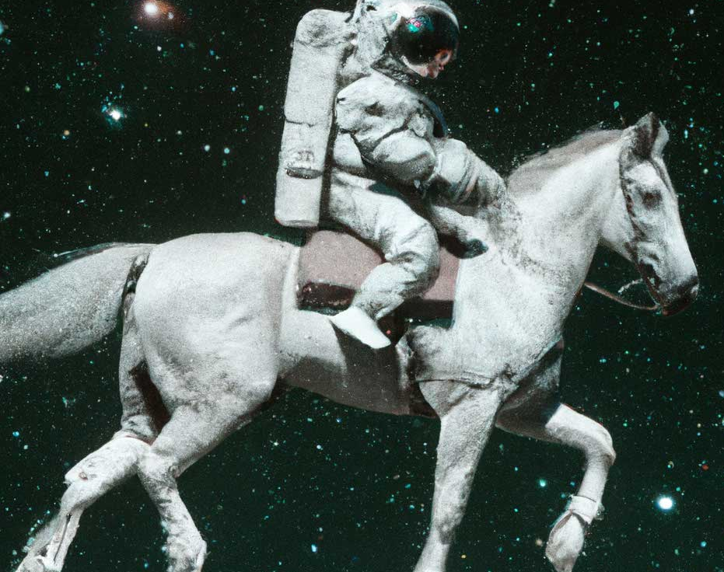
Questions?

